Slide 1
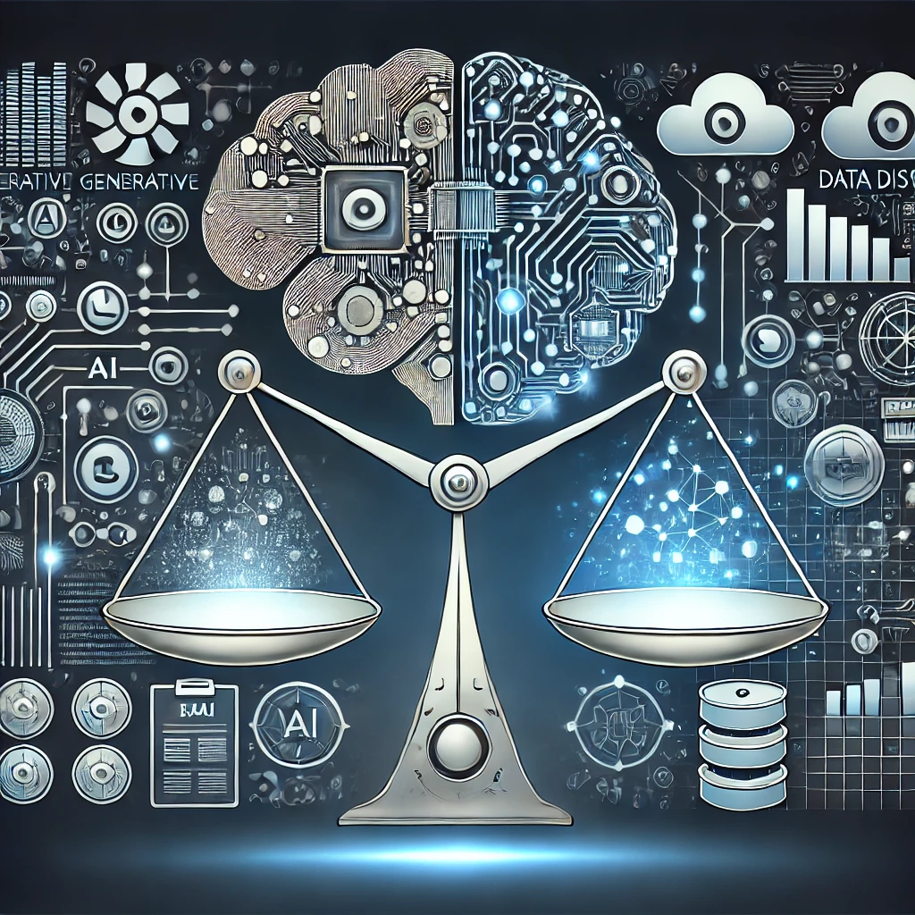


The AI Authenticity Paradox
62ND ROBERT KLEIN UNIVERSITY LECTURE
Koen Pauwels, Northeastern University
Note: References are available upon request.

Slide 2
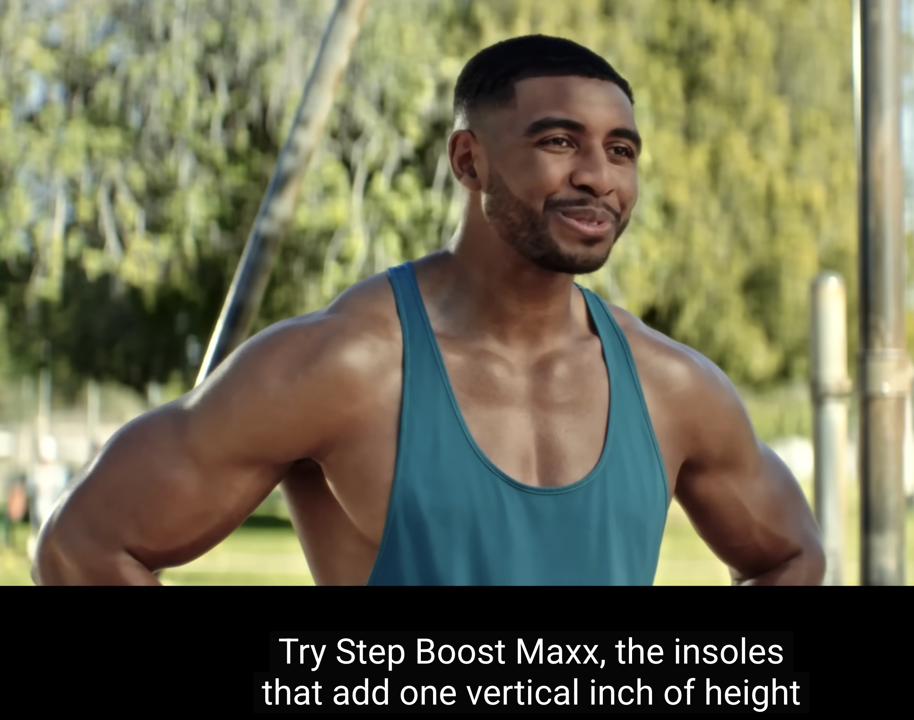
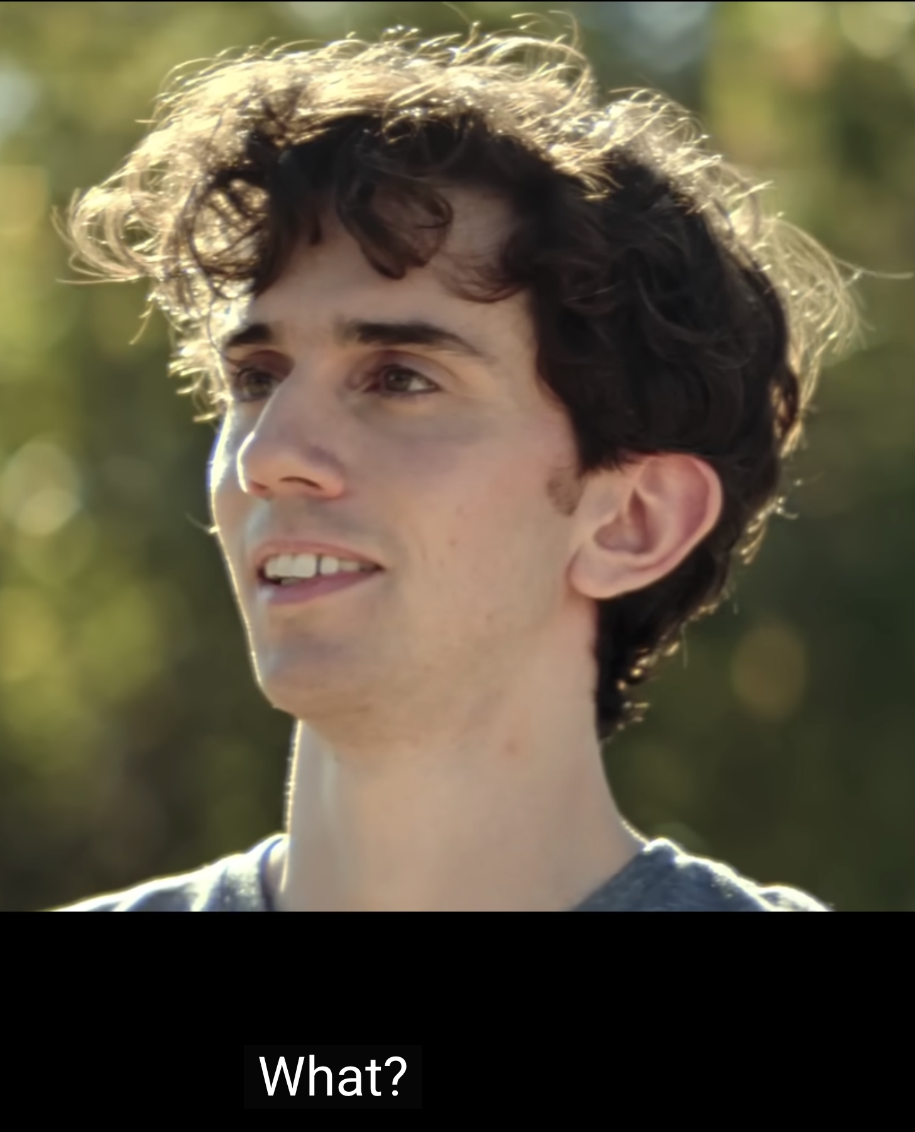
What was this Superbowl ad all about?

Slide 3
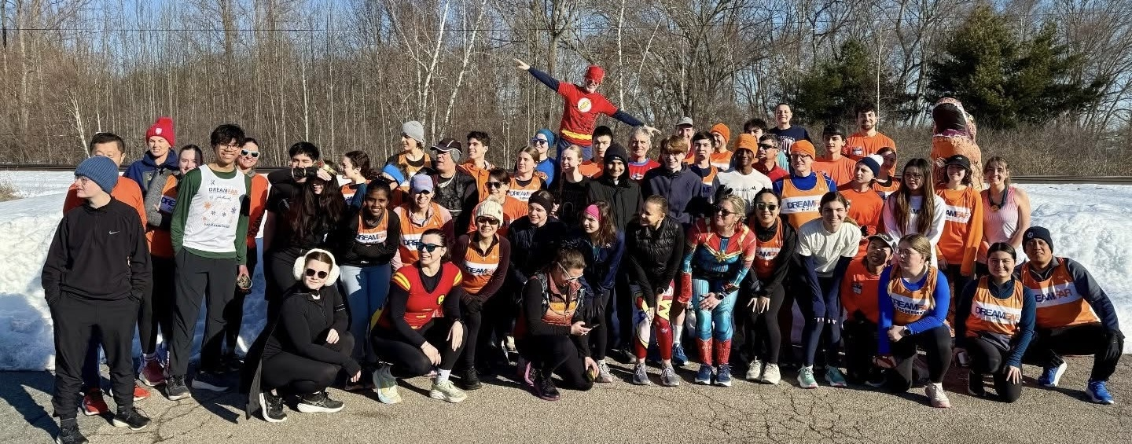
And how does this picture make you feel?

Slide 4
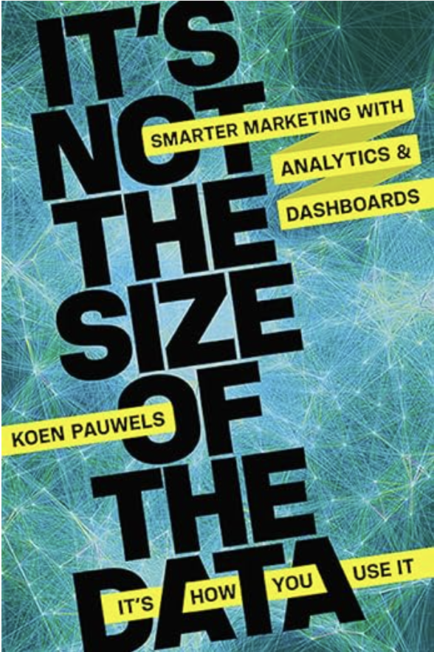
Roadmap
The AI Authenticity Paradox
What my research reveals
Examples in Business and University
Prediction and recommendations
Questions for the audience

Slide 5
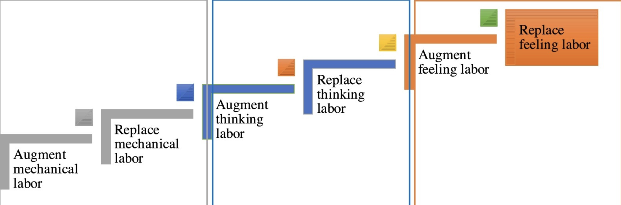
The AI
Authenticity
Paradox
As AI is improving human-like communication
We get MORE attuned to what is genuinely human
In Business, Research and Society:
Human judgment becomes MORE valuable
AI capabilities grow over time (Huang and Rust 2024)

Slide 6
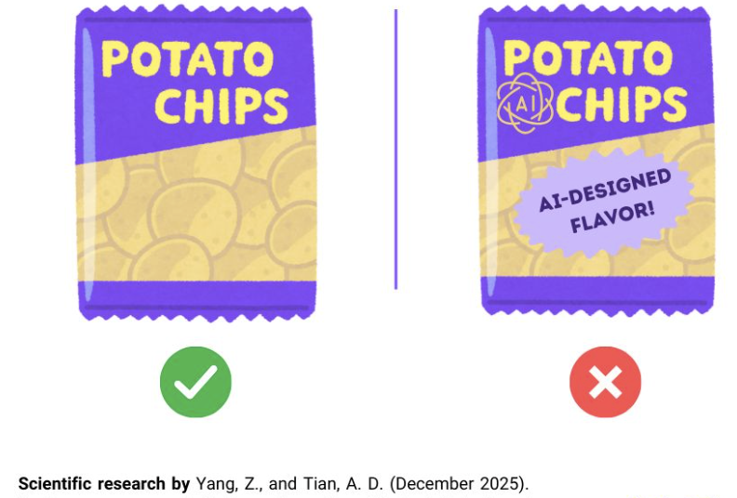
AI aversion well documented in marketing
AI has improved in accuracy
But even when objectively better
Humans dislike and avoid
AI-supported, designed, edited
Products and Experiences

Slide 7
My Research on AI in Business
Beneficial framing matters in passive exposure
AI Literacy → self-investment → privacy value
Both employees and customers need to adopt

Slide 8



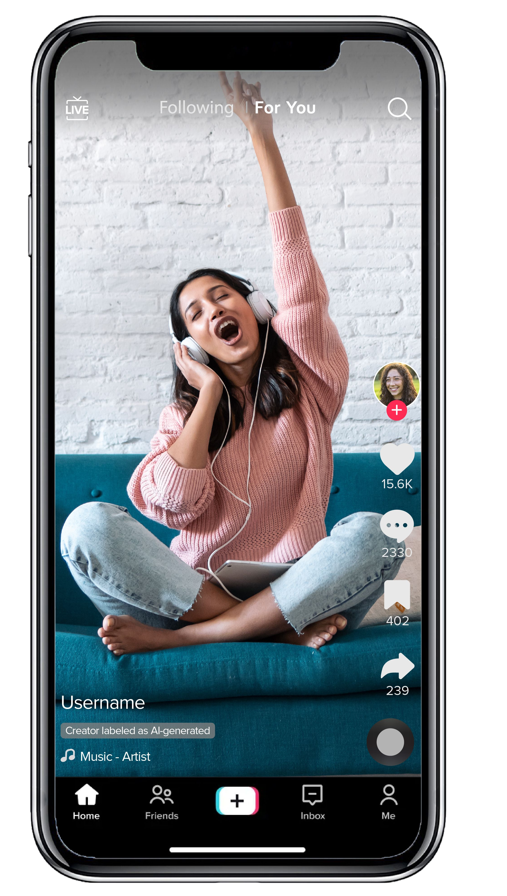
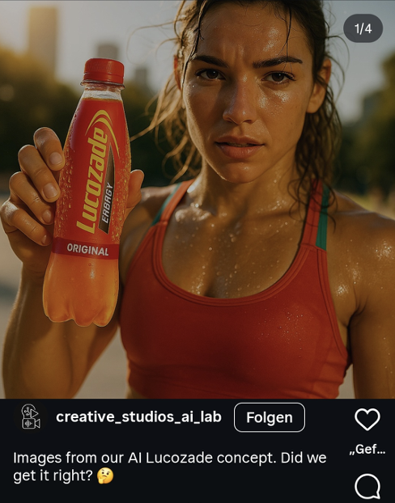
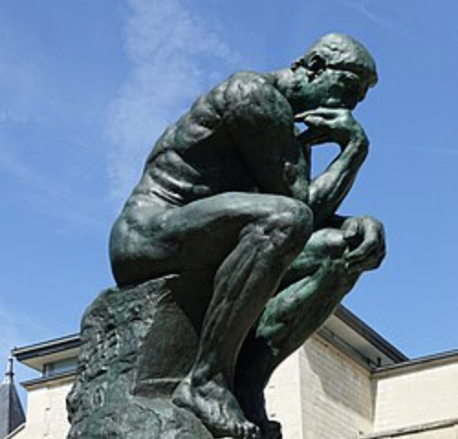


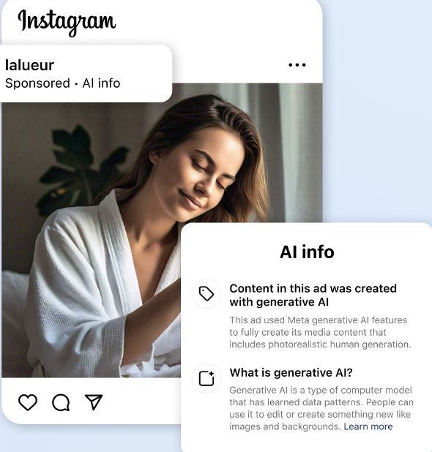


1) Frame your AI disclosure for benefits
Stimulus
Organism
Response
Processes
Attitudes
Input:
AI generated ads (Tiktok, Meta)
Cognitive
Affective
Ad-related
Brand-related
Product / charity attitudes
Intentions
Purchase / payment
Engagement on social media
Customer loyalty
Consumer perceptions
attitude formation
Behavior
AI Disclosure
Click-through-rates (banner ads)
Donation behavior
Online engagement
Pauwels, Bart, Buder and Schreiner, 2026
Disclosure / „awareness of falsity“

Slide 9
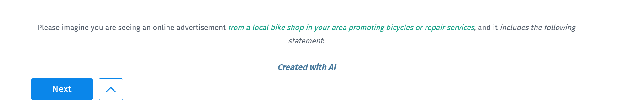
We test consumer, company, employee environmental benefits
Beneficiary | Specific explanation | Unspecific explanation | Benefit
Baseline | „Created with AI“
Consumer self-benefit | “Created with AI to tailor this ad more closely to what matters to you, helping us show the product in a way that fits your everyday needs.” | “Created with AI to tailor this ad to your needs” | Personal relevance / personalization
 | “Created with AI to offer you better value: less time spent on expensive ad production means more resources can go into product quality.” | “Created with AI to offer you better value and quality” | Higher consumer value quality focus
Company self-benefit | “Created with AI to reduce the time and cost of producing marketing materials, helping us operate more efficiently.” | “Created with AI to work more efficiently as a company” | Efficiency
 | “Created with AI to simplify internal workflows and speed up campaign production, allowing us to bring new messages to market faster.” | “Created with AI to speed up how we create our campaigns” | Pace
Other benefit | “Created with AI to automate repetitive layout and editing steps, giving our creative team more time to focus on the core idea behind the campaign.” | “Created with AI to free our creative team from repetitive tasks” | Less routine work
 | “Created with AI to avoid resource-intensive photo and video shoots – helping reduce emissions and waste from our ad production.” | “Created with AI to reduce the environmental impact” | Lower environmental footprint

Slide 10


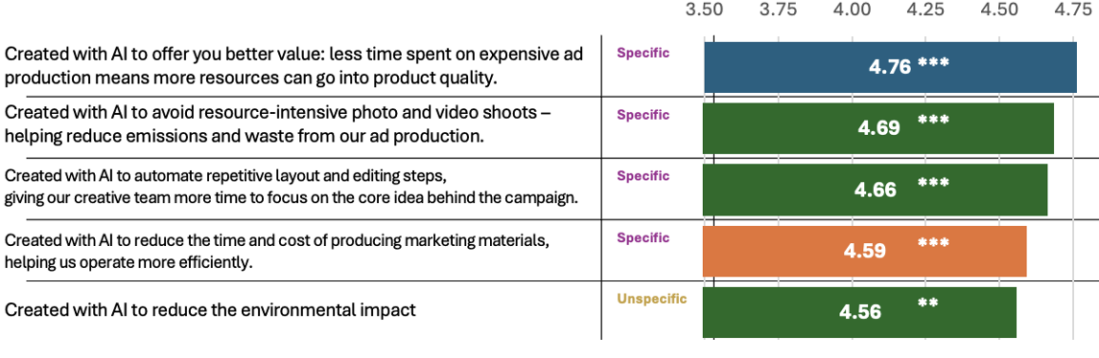




Advice: be specific, especially about others
Specific explanations outperform for consumer & environment

Slide 11


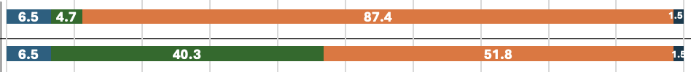

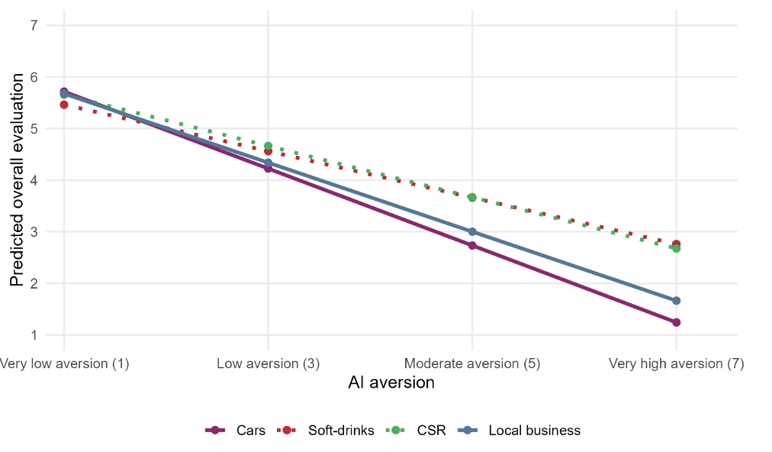

Individual AI aversion is the strongest predictor
Credible? Most consumers believe you’re doing it for the company
AI aversion strong predictor,
especially in high involvement

Slide 12
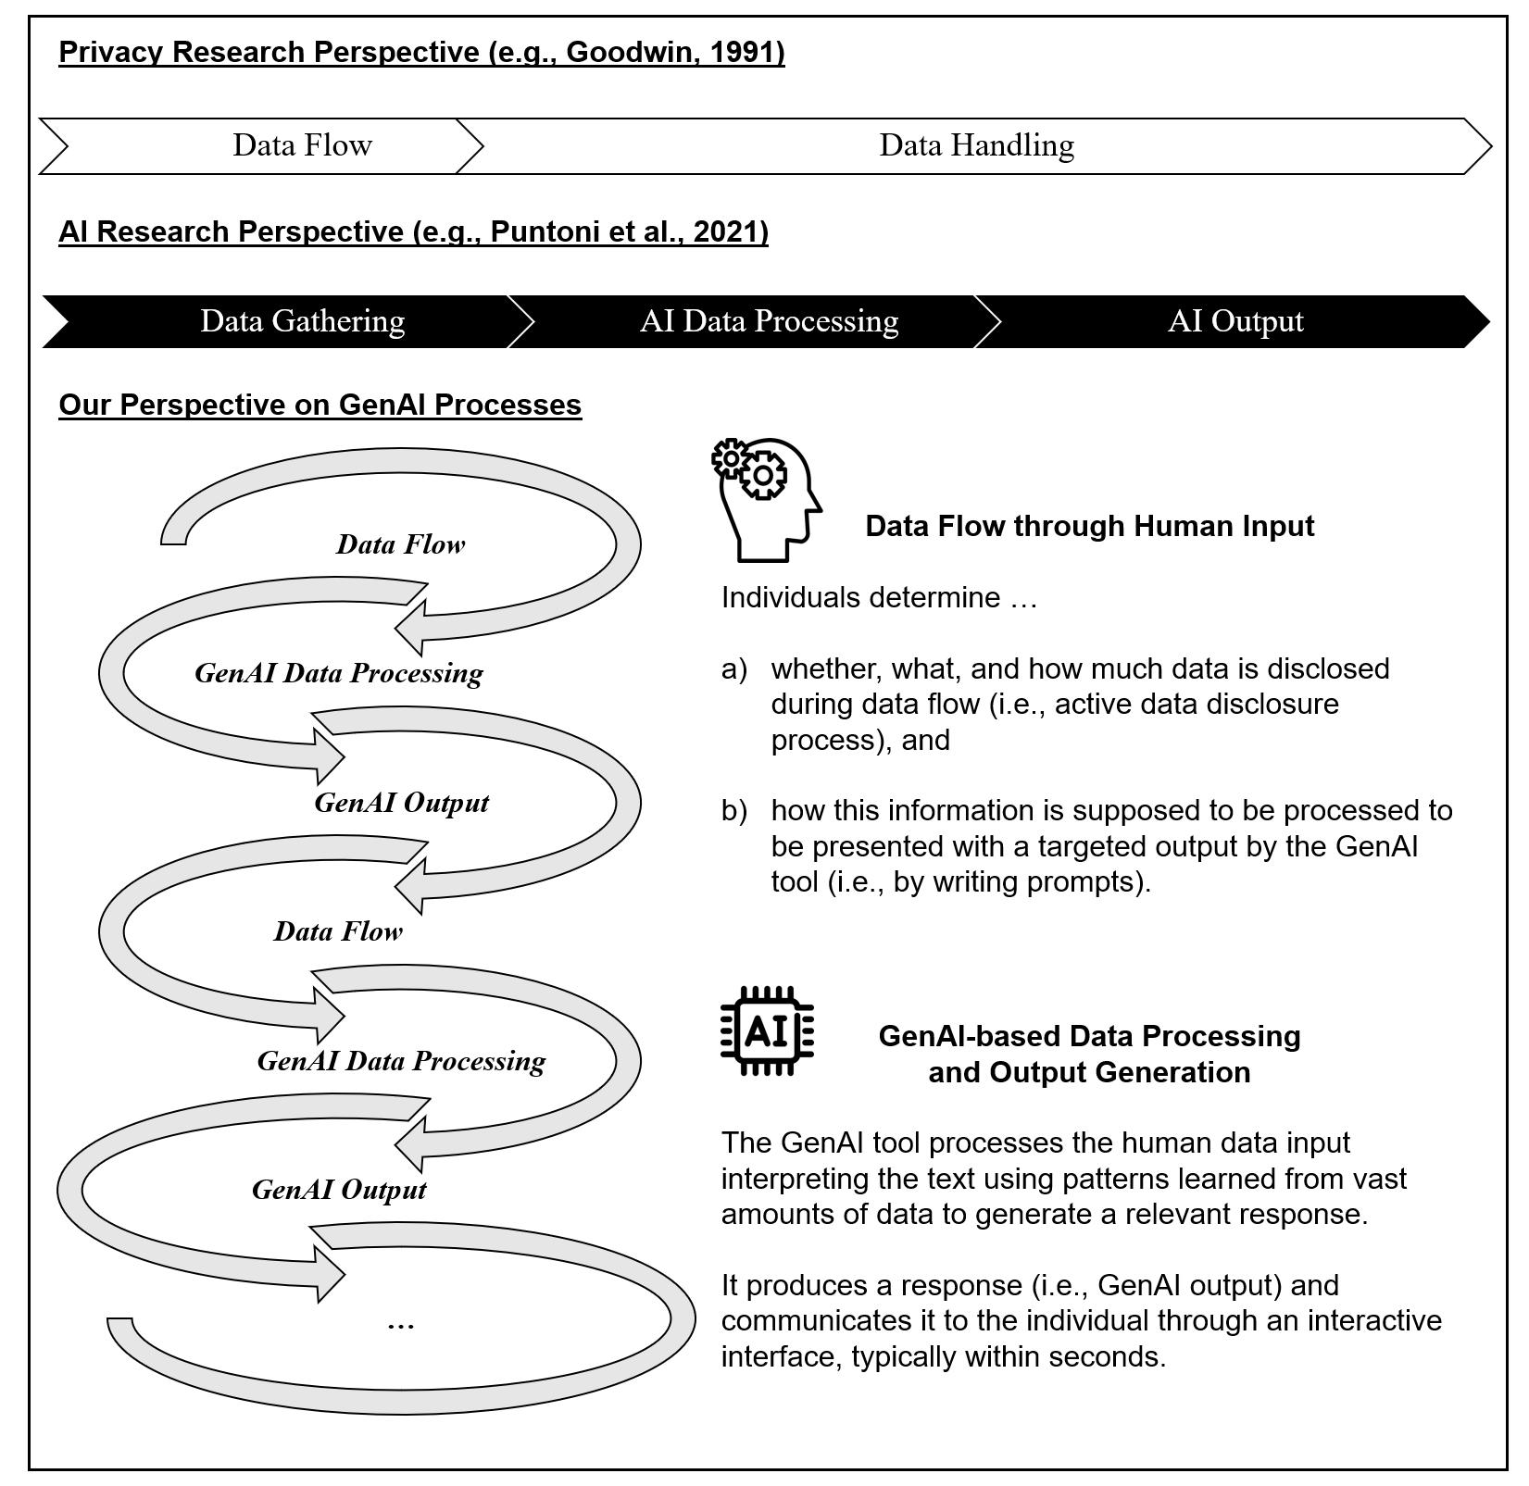
2) Beyond passive exposure, we cocreate with AI
Old Privacy: data flow and handling
In contrast, GenAI enables an interactive and iterative disclosure process where users actively shape both the input and the output.
Process reflects self-investment, where users contribute effort, data, and intent to co-create valuable, tailored outputs.
Notes:
As a first step, we tried to understand why GenAI data disclosure processes are different.
Traditionally, data disclosure is divided into two stages…
These stages align with the structure of AI processes proposed by AI research; what both of theses perspectives have in common is that they are linear, that individuals do not have control over their data after data disclosure, and the value of data disclosure, or rather, privacy value, is mainly created by the data recipient.
In contrast, GenAI data disclosure is interactive and iterative, allowing individuals to actively shape the output or value by investing themselves. They determine: a) whether what and how much data is disclosed and b) how the information is supposed to be processed to receive a targeted output.

Slide 13
Across 4 studies and 2 continents, AI literacy → Self-investment → Privacy Value
Privacy Calculus
Perceived Benefits
(S2-S4)
+
+
AI (Prompt) Literacy (S1, S2)
+
Self-Investment (S1-S4)
+
Perceived Output Ownership
(S1-S4)
Perceived Privacy Value
(S1-S4)
Perceived Privacy Risks
(S2-S4)
-
-
+

Slide 14
a) Field Experiment in Germany
t-1
t
t+1
Questionnaire 1; N = 157
AI Literacy Training
Questionnaire 2; N = 74
Dyads for analysis: N = 58
“The course program is designed for professionals in marketing, bridging foundational technological principles with critical strategic considerations. Key modules address the legal and ethical landscape, copyright issues, and the mitigation of inherent biases in generative AI. The focus is practical application through advanced prompt engineering and a structured, three-phase quality assurance framework to ensure effective implementation.”

Slide 15
Results: AI use literacy increases self-investment and privacy value
ΔPerceived AI Use Literacy
b = .312, p = .039
ΔPerceived Self-Investment
ΔPerceived AI Evaluation Literacy
b = .009, p = .546
b = .365, p = .003
ΔPerceived Self-Investment
b = .470, p = .001
ΔPerceived Privacy Value
ΔPerceived AI Use Literacy
Notes:
Use Dimension:
I can skillfully use AI applications or products to help me with my daily work.
It is usually hard for me to learn to use a new AI application or product.
I can use AI applications or products to improve my work efficiency.
Evaluation Dimension:
I can evaluate the capabilities and limitations of an AI application or product after using it for a while.
I can choose a proper solution from various solutions provided by an AI application.
I can choose the most appropriate AI application or product from a variety for a particular task.

Slide 16
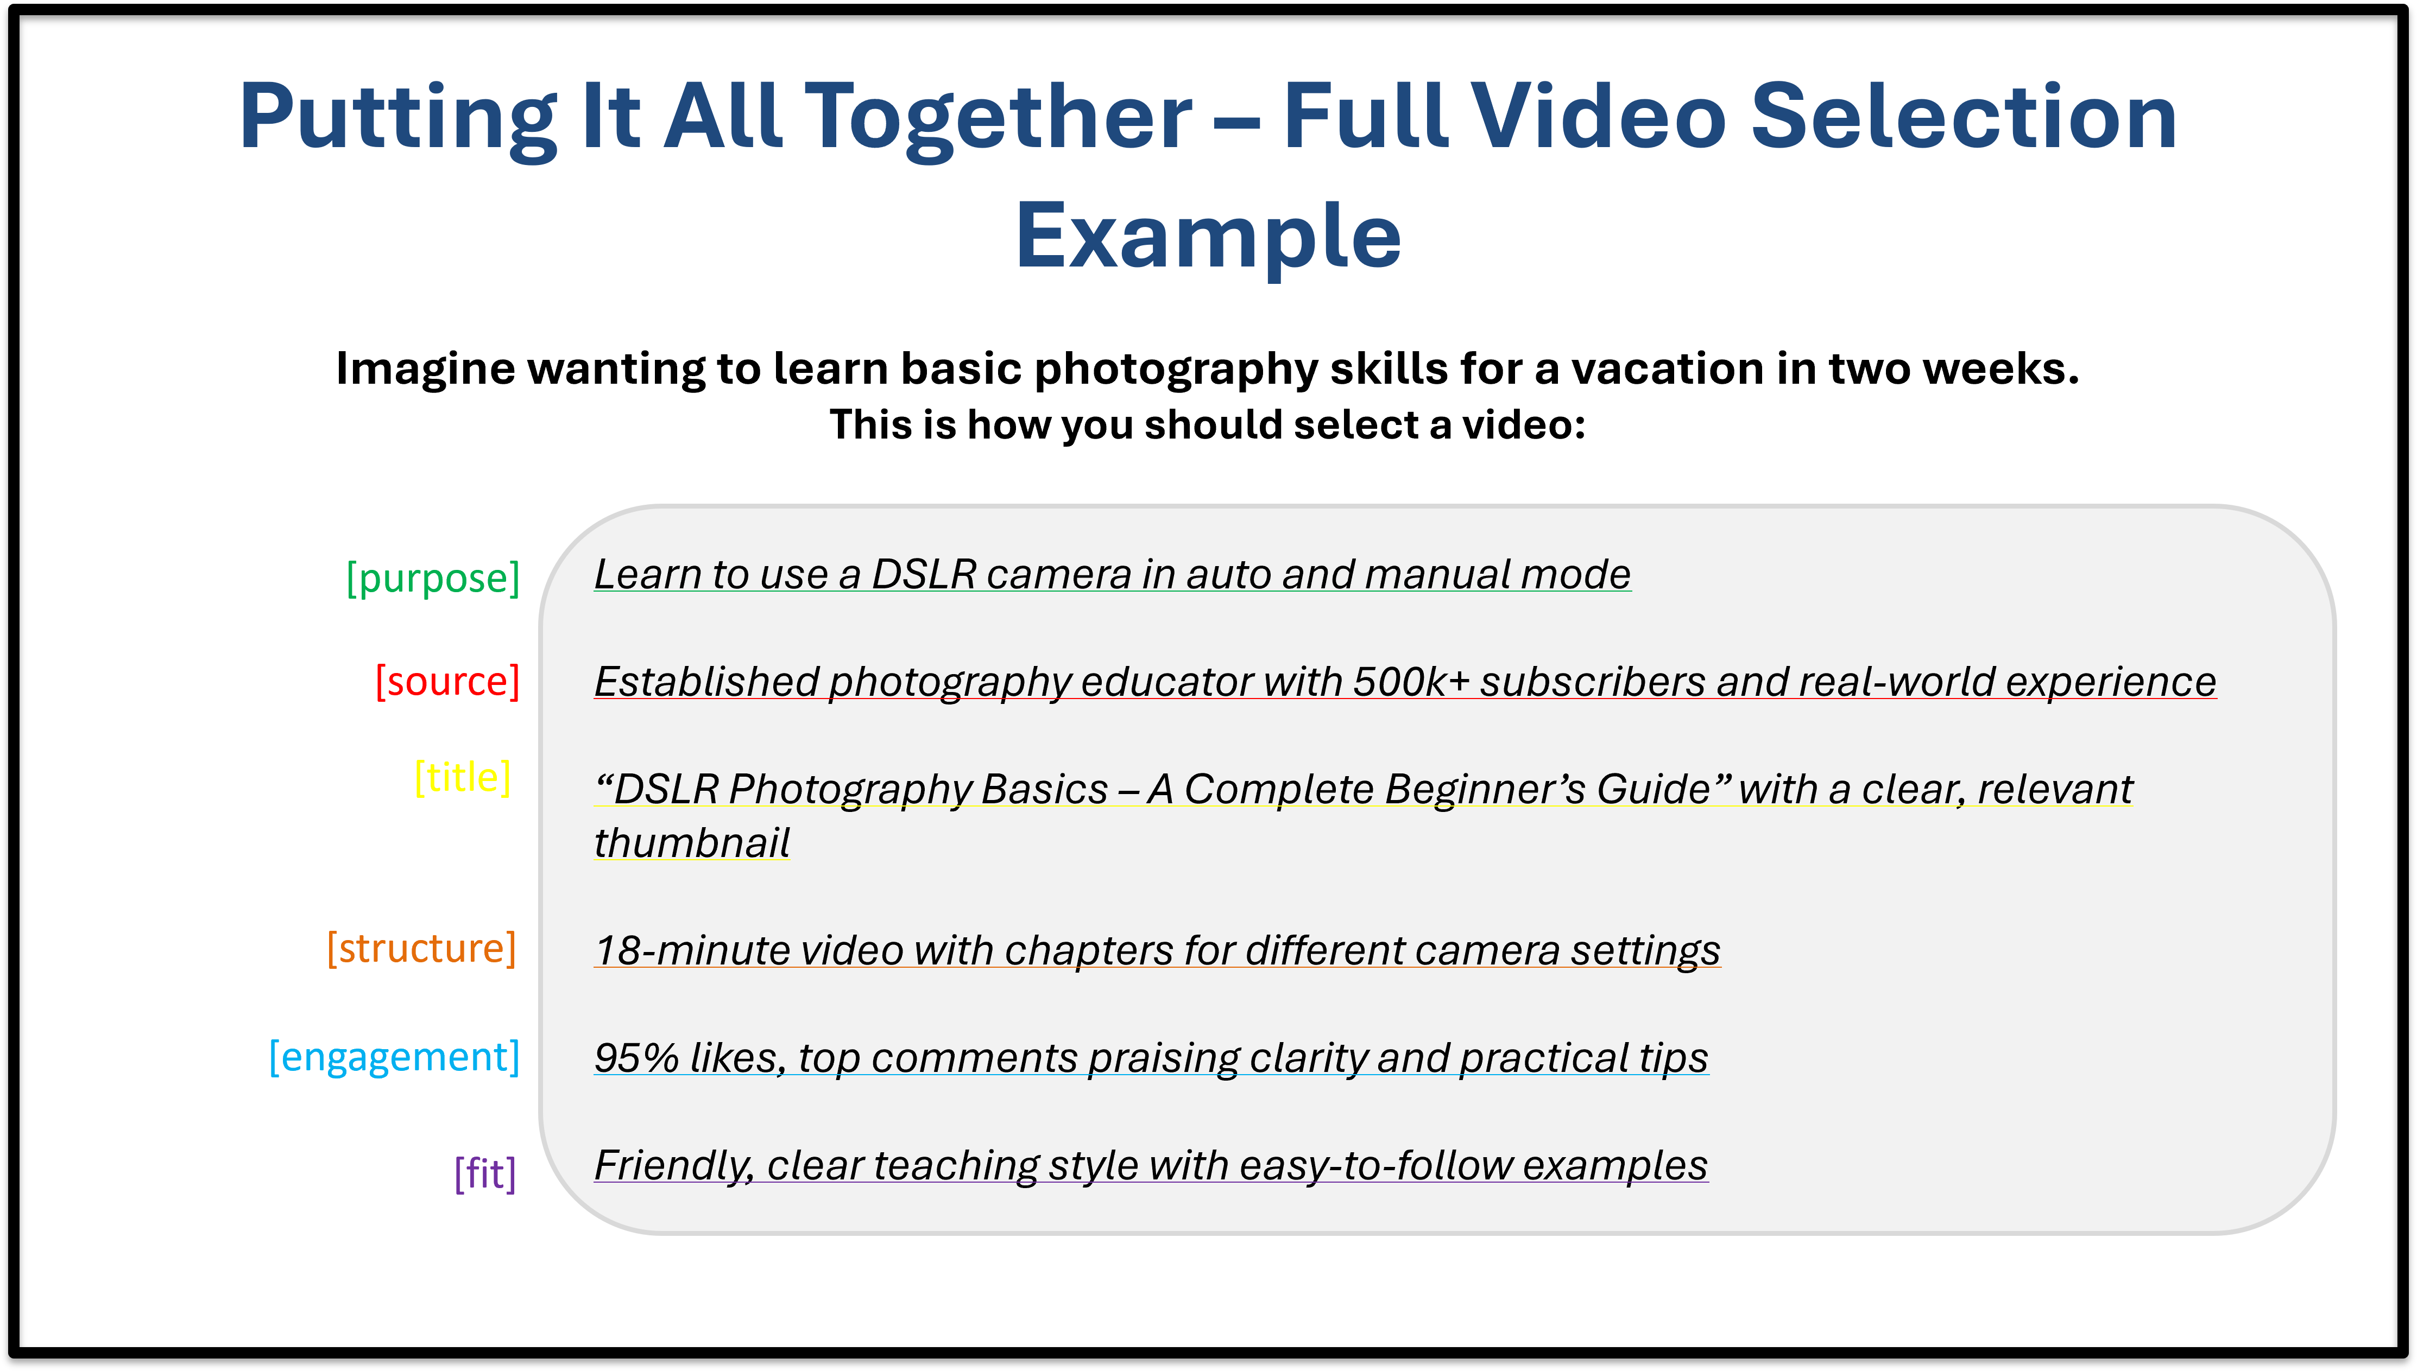
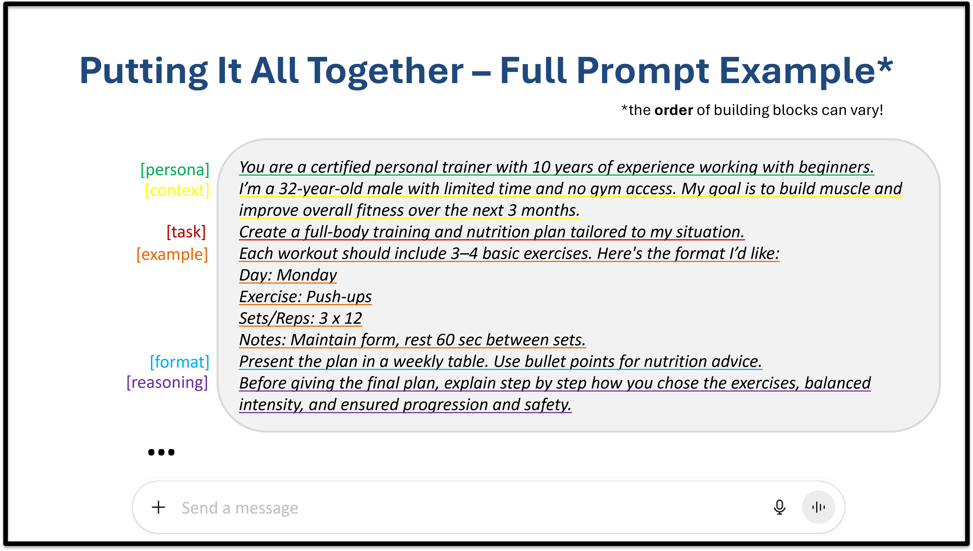
b) Prompt Literacy experiment with Northeastern University Students)
Control Group
(Youtube Video Selection)
Treatment Group
(Prompting Literacy)
📝
Job Application Letter
Task: “Please write a prompt to help you craft a cover letter.”

Slide 17
Literacy increases privacy value indirectly through self-investment, ownership
n.s.
Privacy Calculus
b = .30, p = .0000
Perceived Benefits
b = .58, p = .0000
Prompt Literacy (no vs. yes)
Perceived Self-Investment
Perceived Output Ownership
Perceived Privacy Value
Perceived Privacy Risks
b = .28, p = .0145
b = .71, p = .0000
b = -.16, p = .0002
b = -.13, p = .0000
b = .19, p = .0121

Slide 18
Across all studies: Full mediation through ownership, mostly through benefits
b = .572, p = .007
b = .129, p = .068
Perceived Benefits
b = .315, p < .001
Perceived Self-Investment
Perceived Output Ownership
Perceived Privacy Value
Perceived Privacy Risks
b = -.125, p = .085
b = -.120, p = .057
n.s.
Indirect effect:
Self-Investment – Ownership – Benefits –Privacy Value: a × b = .0207, 90% CI [.0009, .0573]
Self-Investment – Ownership – Risks –Privacy Value: a × b = .0071, 90% CI [-.0007, .02014]

Slide 19
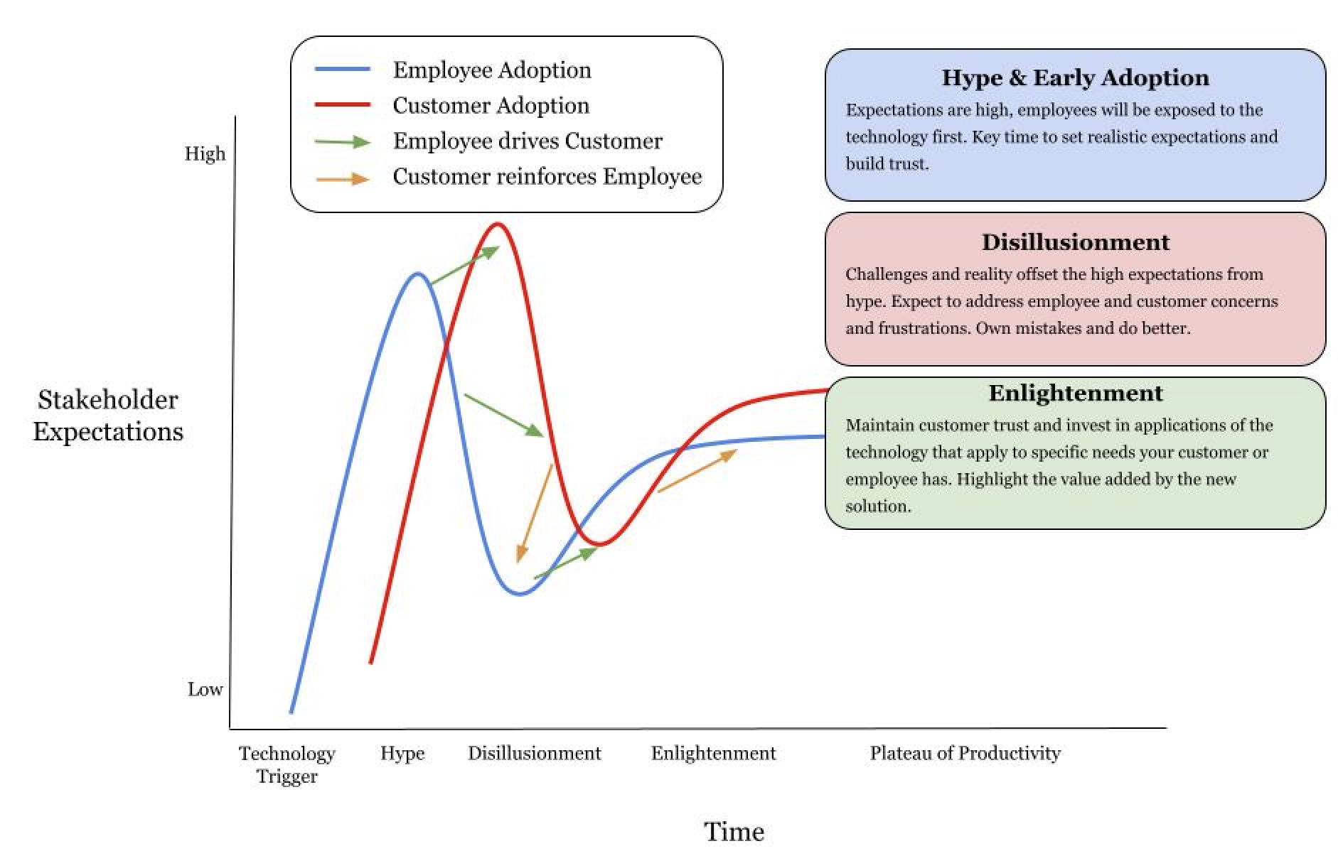
3) Interlocking adoption cycles need leadership in Blockchain, ERP, Electric Vehicles, VR, AI
Hype | Disillusionment | Enlightenment
Set realistic expectations for customers and employees e.g. MSI, NE NOT Amazon, Meta Horizons | Reskill employees to prevent despair eg Ikea chatbot NOT: Hershey ERP | Grant agency to employees e.g. Helium dashboards
 | Offer tangible customer benefits eg Hilton VR tours Louis Vuitton BC | Maintain value for money eg TetraPak NOT Tesla

Slide 20


Human Authenticity continues to matter
Target pregnancy prediction → promotion
In-person, organic word-of-mouth > online, sponsored
Verified purchase reviews on Amazon

Slide 21
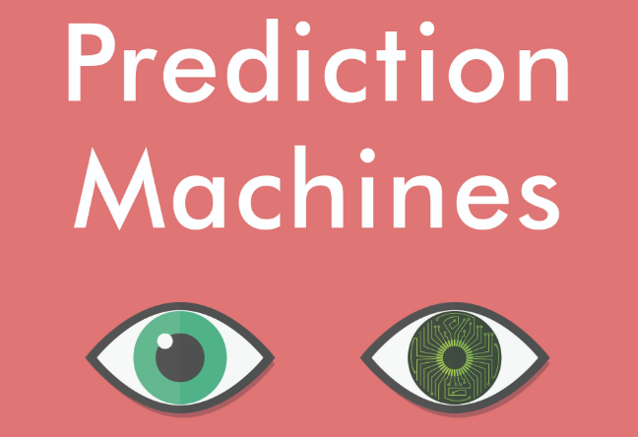
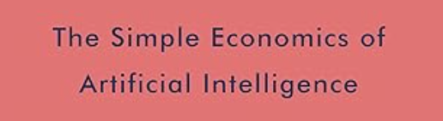
As AI predicts better, human evaluation key
Prediction (AI) | Judgment (Human) | Decision (Together)
Precise weather forecast: 63% chance of rain to class | Cost of getting caught in rain Cost of carrying umbrella in sun | To take or not take the umbrella That is the question
Superbowl ad dissing competitor reaches 100M people | Enhance or reduce trust? Long-term competitive benefit? | Is it worth the $10M price tag? Alternatives to reach goal?
Cash transfer poverty by 18% | Dignity, agency, fairness? | Fund the program by how much?

Slide 22
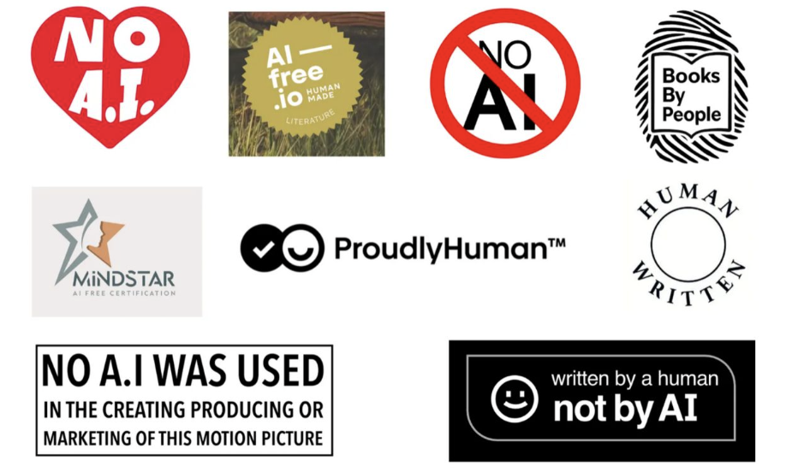
My Prediction: human-made price premium
Northeastern's applications up despite free online courses
Etsy now certifies "handmade”
Substack human writers enjoy more loyalty than AI content farms
People no longer pay for information
They pay for a human being who cares
Companies and non-profits from US, UK, AU

Slide 23
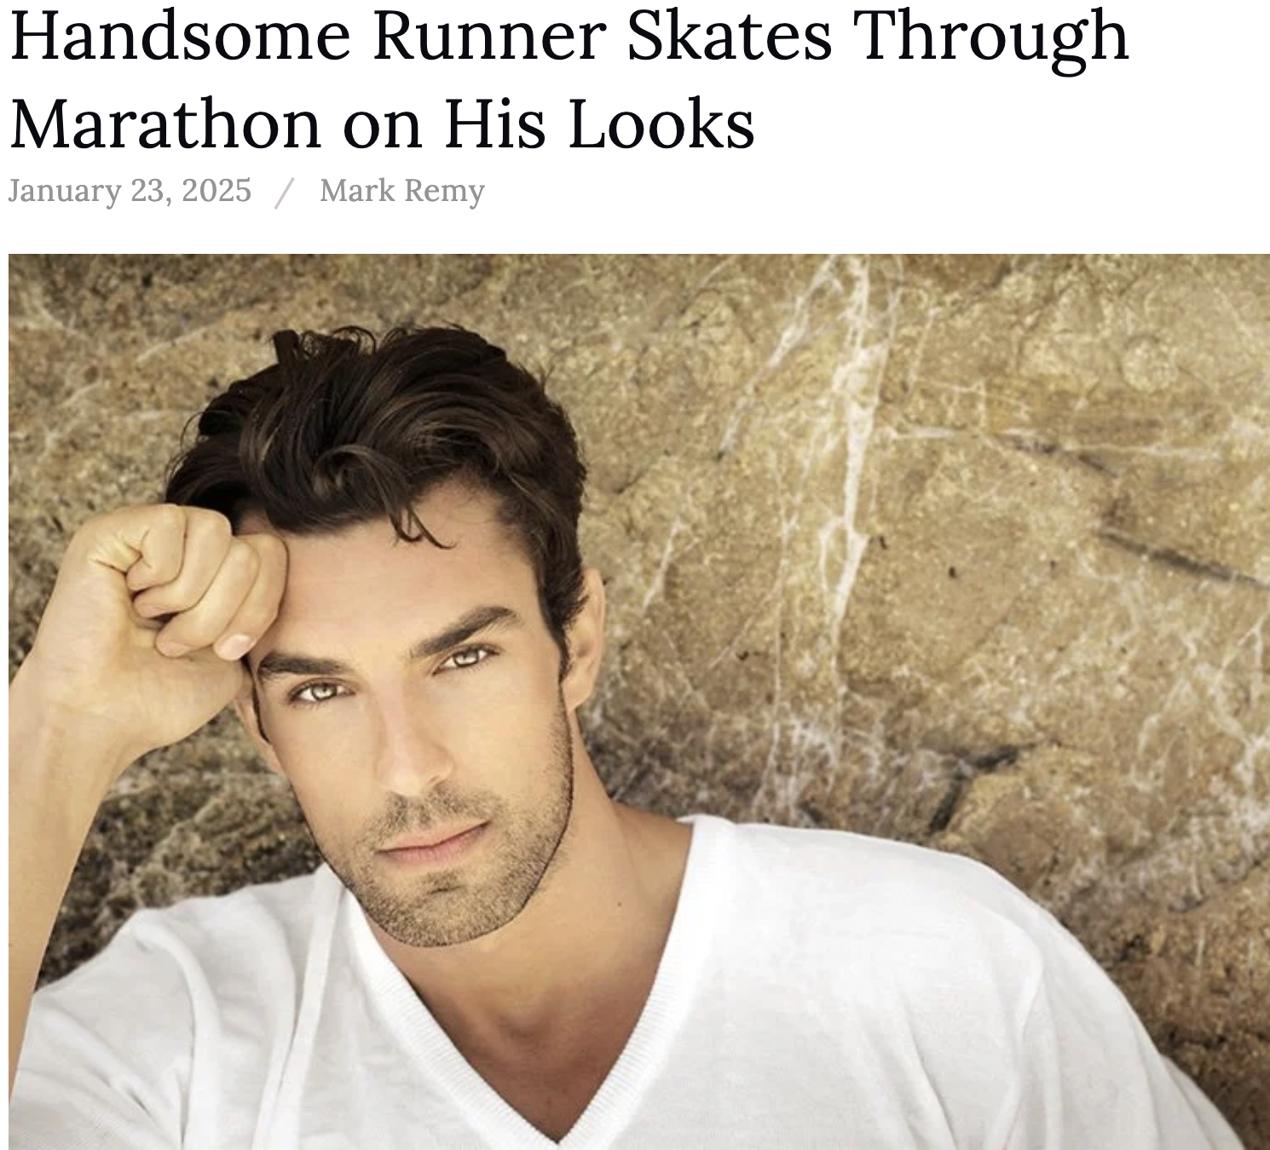
Recommendations
Authentic community eg marathon
Tech changes, humans adapt and find new ways to signal what's real
AI is not end of human expertise
Authenticity, judgment, human connection become more valuable

Slide 24
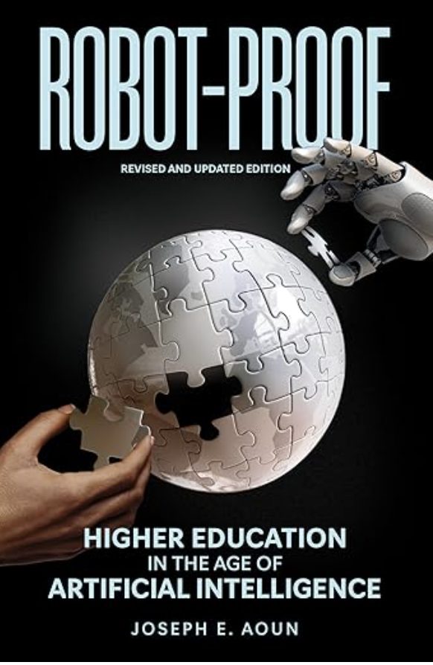
Whereto Higher Education in the Age of AI ?
President Aoun asked in Robot-Proof How do we educate students to invent, create, and discover — to fill needs that even the most sophisticated AI cannot?
My answer: by developing human judgment, lived experience, and capacity to set the objective function AI optimizes

Slide 25
I leave you with 3 questions
For students: What expertise are you building that requires lived experience (how-to), not just knowledge or access to information?
For NE employees: What are we actually certifying when we grant a degree in a world where AI can produce much of the output?
For all of us: How will you make your human judgment and authenticity costly to fake, visible to employers, worth paying for?
AI is getting better. That's exactly why being genuinely human is becoming more valuable. Choose wisely what you do with that.

Slide 26


INVEST IN HUMANS! THANKS !
QUESTIONS?

