Slide 1


















Slide 2

It’s Not the Size of the Data – It’s How You Use It:
Smarter Marketing with Analytics and Dashboards
© Koen Pauwels, 2025

Slide 3


Case: Inofec BV: Dutch office furniture leader
Office furniture supplier:
2 EU countries, B2B
Positioning:
Quality, excellent service at low cost
Challenge: Need for office furniture arises at specific times, which are hard to predict for the company
t
Notes:
3

Slide 4




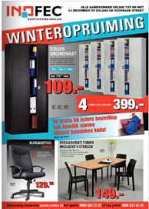



Their Problem: 1 Euro More or Less?
?
?
?
Website
E-mail marketing
Adwords
?
?
?
Flyers
?
Catalogs
SEO
Fax
Notes:
4

Slide 5
Conceptual Framework
Feedback
MARKETING ACTIVITY
Catalog
Adwords
Feedback
Fax
Email
Feedback
Flyer
Benefits
Benefits
Costs
ONLINE CHANNEL
OFFLINE CHANNEL
ONLINE CHANNEL
OFFLINE CHANNEL
Web visits
Web visits
Information requests
Leads (info requests)
Leads (info requests)
Feedback
Information requests
Cross
-
Channel effect
Quote requests
Feedback
Quote requests
Quote requests
Quote requests
Orders
Orders
Orders
Orders
Financial Results
Financial Results
PROFITS
Notes:
5

Slide 6
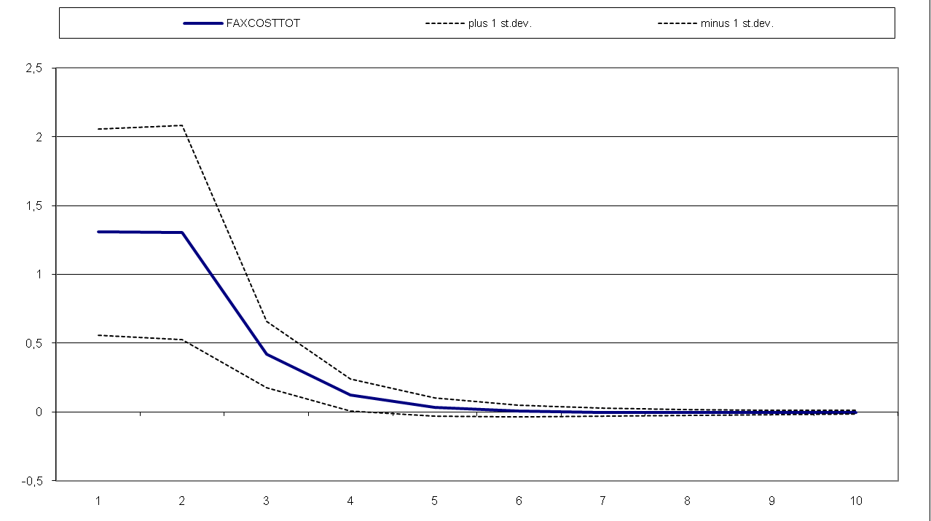
Profit Response: Faxes
Profit
Days
Notes:
6

Slide 7
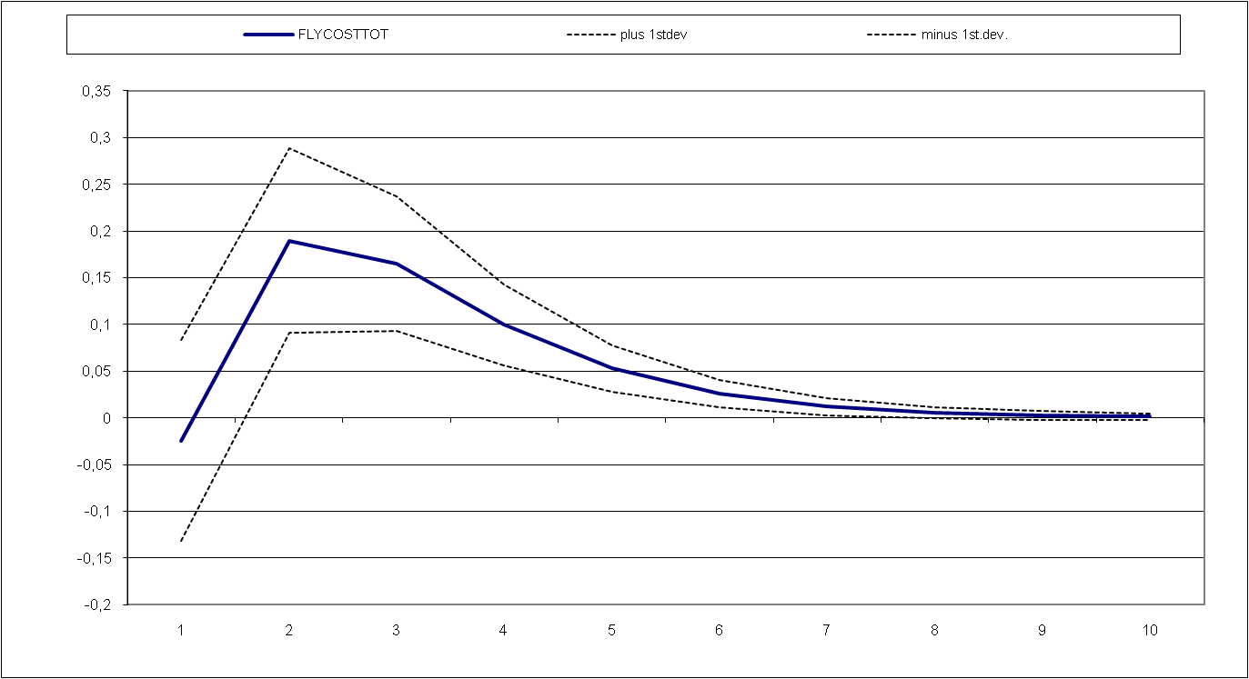
Profit Response: Flyers
Profit
Days
Notes:
7

Slide 8
Profit Response: Adwords
Profit
Days
Notes:
8

Slide 9
Results
Variable | Profit Effect | Sales Elasticity | Wear-In | Wear-Out | 90% Effect
Fax (€) | 3.33 | 0.05 | 0 | 6 | 4
Flyers (€) | 0.57 | 0.04 | 2 | 9 | 5
Adwords (€) | 55.72 | 4.35 | 1 | 9 | 7
eMail (each) | 0.71 | 0.12 | 2 | 5 | 5
Discount (1%) | 789 | 0.75 | 0 | 2 | 1

Slide 10
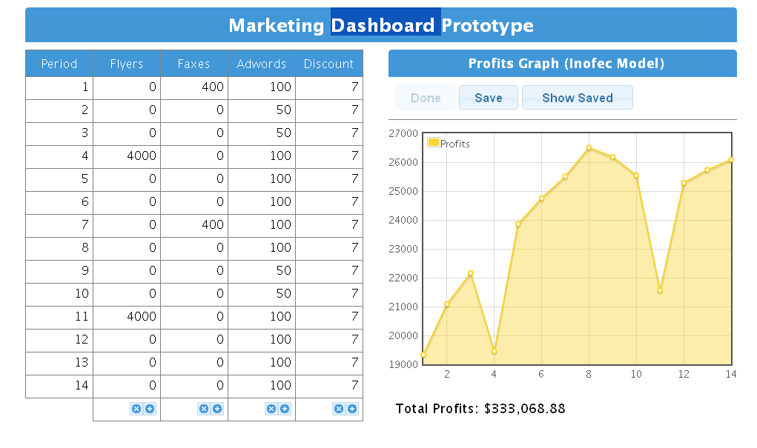
Dashboard input and output

Slide 11
Funnel Progression
Leads
Quotes
Orders
Profit
Flyers
Online
visits
Online
Online
Online
20%
Offline
Offline
Offline
80%
Notes:
11

Slide 12
Funnel Progression
Leads
Quotes
Orders
Profit
Faxes
Online
visits
Online
Online
Online
6%
Offline
Offline
Offline
94%
Notes:
12

Slide 13
Funnel Progression
Leads
Quotes
Orders
Profit
Adwords
Online
visits
Online
Online
Online
27%
Offline
Offline
Offline
73%
Notes:
13

Slide 14
We advise to decrease Flyers, increase Adwords
 |  | Adwords
 |  | High | Base
Flyers | Base | Group 1 | Control
 | Low | Group 2 | Group 3

Slide 15
And test this in a field experiment
 |  | Adwords
 |  | High (* 1.8) | Base
Flyers | Base | Group 1 | Control
 | Low (56%) | Group 2 | Group 3

Slide 16
Net Profit Change is 15 x higher with recommendation
 |  | Adwords
 |  | High | Base
Flyers | Base | € 81.39 | € 10.84
 | Low | € 153.71 | € 135.45
Notes:
16

Slide 17
Experiment Supports Our Assertions
AdWords
  Increase raises profits
  Most of the profit increase shows up in offline orders
  Higher spending of 17.66 euros per day is more than offset by the higher profits, in either ‘Flyer’ condition
Flyers
  Average daily savings of 137 euros a day are substantially higher than the profits lost from lower sales
  Do not panic and invest in flyers if there is budget left

Slide 18
Take-aways from field experiment
Structure comparative tests to find higher impact actions
Measure impact on sales and/or funnel progression
Improve efficiency and effectiveness of funnel progression

Slide 19



Let’s track mindset metrics and link them to sales
Marketing
builds
Attitudes
What marketers do
What customers think & feel
which convert
to Brand Sales
What customers do

Slide 20
Metric Pitfalls (from Marketing Leadership Council)
Tracking measures that only marketing cares about
Collecting as many metrics as possible
Displaying metrics in a non-user friendly format
Presenting interesting data without clear next steps

Slide 21

Measuring the Wrong Drivers:
Company | Measured | Customers wanted
Continental Airlines | On-time departure | On-time arrival
 | Selection of Beans | Clean Store
 | New beverages | Friendly Staff
 | High Quality Tea | Fast service

Slide 22
The KPI Wheel of Metric selection (My book Ch. 7)
WHAT business question would that metric answer?
WHO will use it to make decisions and take action?
HOW Important is it compared to other metrics?
WHERE will the supporting data come from?

Slide 23
First four Rules to drop a candidate metric
Does the metric rarely change?
Is it too volatile to be reliable?
Does it add little to existing metrics?
Is it a (dis-) aggregate existing metric?
Ambler, Tim, Marketing and the Bottom Line, 2001.
Notes:
If availability is guaranteed, it does not change over time
awareness surveys at the weekly level often too volatile or depending on sample size
If sales on promotion always the same proportion of total sales
sales by segment sum up to sales: they are simply diagnostics, not metrics

Slide 24
Next 4 rules apply especially to brand metrics:
1) Are the metrics very similar (convergent)?
e.g. perceptions & attitudes, choice & intention
2) Do we have the necessary data?
3) Do metrics cover main customer levels?
4) Are metrics leading indicator of $ results?
which metrics predict trouble (and success) ?
Notes:
3) If trade customer important, keep its metrics, while reducing end user metrics
4) Regression (multivariate techniques) of sales/profits on last period’s brand metrics, or Granger causality
Need as many indicators as there are likely causes for failure!
If no sufficient data for quantitative analysis: expert opinion eg Delphi

Slide 25

Pauwels’ criteria to evaluate a metric
  Responsiveness to Marketing
  Conversion to Sales

Slide 26

1) Responsiveness: can we move it?

Slide 27

2) Conversion: does it translate into sales/profits ?

Slide 28


Love Marks or Safe Bets ?
 | Low sales conversion | High sales conversion
Low ST response to marketing | Consideration Mature Markets | Consideration Emerging Markets
High ST response to marketing | Liking Emerging Markets | Liking Mature Markets
Notes:
Lovemark = mystery, sensuality and intimacy: from irrepleacable to irresistable

Slide 29
7 Dashboard best practices
Best practice | Meaning… | Examples
Start with business | Marketing knows business model & funnel progress | Unisys, Ameritrade, JP Morgan, Lenovo
Standardize metrics | Common and consistent definitions and measures | Avaya, Zurich, Google
Simplify and target | Tailor views to audience | Google
Insert in meetings, planning process and compensation | Review in executive meetings and as part of budget & planning process | Vanguard, Avaya, Ameritrade
Prune the board | Delete metrics that do not provide insights | Lenovo, CA
Sharing | Create networks of sharing | Zurich, Avaya
Direction > precision | Track softer metrics when hard metrics not yet there | Google, Lenovo

Slide 30
Which metrics are actually tracked:
Firm | Metrics tracked
Coca-Cola | Daily drinking, ad awareness, affinity, value, taste perceptions
Google | Acquisition & retention rates, revenue per active customer by product, country and channel
JP Morgan | Leads generated, revenue by campaign, number of clients touched, number of podcasts downloaded
Lenovo | Awareness, preference, consideration, image, weeks of inventory, abandonment rate, site engagement, path usage
Zurich | Awareness, consideration, preference, acquisition, retention, cross-sell, communications input/output/impact

Slide 31


Start the performance journey in your company

Slide 32
Successful dashboard implementation steps
(Chapter 12: Dashboard implementation, Pauwels)
Obtain top management support
Identify the project team
Define project scope and budget
Gather requirements for stakeholders
Define key metrics and their data source
Design and construct a prototype
Test prototype and adjust
Launch the project

Slide 33
How to obtain top management support?
Focus on the need for accountability culture (threat)
Give specific examples (supported with numbers) on how your firm (or a firm like yours) can substantially increase profits/goals and with better efficiency
Demonstrate functionality and usefulness of a dashboard application (build a simple dashboard or select a dashboard example available online : see e.g. www.dashboardinaction.com)
Show industry/market trends of dashboard use

Slide 34
Which cultural triggers increase the need?
1. Information overload, need to manage by exception
2. A desire to focus the firm on targeted metrics that both reflect and affect business performance.
3. A crisis that requires accountability throughout firm
4. Higher expectations, countries, industries, channels
Dashboards drive a culture of transparency as they monitor progress toward achieving goals at each level

Slide 35
How to stimulate employee engagement?
Explain the role of an employee in the project and his/her impact on the company’s performance;
Emphasize employee benefits: ability to track, ad-just , improve and show personal performance;
Encourage a dashboard trial;
Invite employee feedback and use it in dashboard;
Incorporate dashboard into day-to-day operations;
Develop performance-related incentive scheme.

Slide 36
How to ease employees into the cultural changes:
drip feed the technology over time: becomes part of the user desktops, and soft training (seminars, e-presentations, etc.) is provided but not enforced
More effective: the firm requires dashboards as the standard tool for viewing the business, for delivering critical messages to employees, and for completing individual performance evaluations.

Slide 37
Recent recommendations from companies
1. Above all, get started NOW. Learning curve: the longer a firm has worked on this journey, the happier they are with it.
2. Ensure you’re using some kind of metric on your marketing.
3. Be ready to invest in getting some data on these metrics.
4. Coordinate your traditional and digital media campaigns
5. Set specific measurable objectives for all your campaigns.
6. Put ROI in stated objectives for all your vendors (so they know your expectations to retain them or to cut them loose)
7. Link marketing ROI to employee compensation, as a bonus.

Slide 38
After basics, move on to best practices
1. Ensure finance accepts your marketing metrics
2. Make sure your data is: timely, actionable & linked
3. Improve econometric models for what-if forecasts
4. Share your data across your organization
5. Develop new metrics for innovative marketing
6. Give employees the initiative to show leadership

Slide 39
Dashboard are not easy to get right
“A dashboard is not something you simply decide one day to implement. An effective marketing dashboard requires a similar process and planning as building a house does” Laura Patterson, Vision Edge Marketing
“You must be prepared to change the processes internally to gather the data and create the ability to track the metrics that will be on your dashboard. It takes time and investment to make the necessary changes”, Deepak Advani, Lenovo

Slide 40
Borenstein: “YOU DON’T NEED SOFTWARE. YOU NEED COURAGE AND VISION !”
“It is possibly the single most important opportunity, in a decade, for your management to reinvent. But to do so you need to have good metrics, measurements you can trust and from which you can make sound decisions that advance your company's business plan. You need to measure what really counts. Once identified, these metrics should then be placed in your Dashboard.”

