Slide 1
AI & Agentic Marketing
Separating Signal from Story
Koen Pauwels
Distinguished Professor, Northeastern University and Editor-in-Chief, IJRM
For UPA in Milano, July 8, 2026

Slide 2
OPENING
Two Questions for You
1
2
How many of you have heard that AI will transform marketing?
How many have actually transformed marketing because of AI?
That gap is the subject of this talk.

Slide 3
ACT I — REALITY CHECK
Most Are Running Experiments, Not Operations
88%
23%
27%
of organizations use AI
in at least one function
have begun scaling
agentic AI anywhere
of marketers call AI agents
top trend, but don't deploy them
McKinsey State of AI, 2025
McKinsey State of AI, 2025
Marketing AI Institute, 2025
The gap between those first two numbers is where the hype lives.

Slide 4


ACT I — REALITY CHECK
Three Narratives Already Proven Wrong
AI replaces the marketer
"Too many brands treat tech like theater, chasing attention rather than solving real needs." Raja Rajamannar, ex-CMO Mastercard. “I hope you no longer fear for your job but do for AI errors at next audit” Shenan Reed, Global CCO, GM
More content = more relevance
"Speed and volume help only when the creative has a strong point of view. If any brand could have done it, it won't stand out." Duolingo CMO. “AI provides the floor, humans give the ceiling” Teresa Barriera, CMO Publicis-Sapient, CMOTalk USA
AI-generated content performs on par
Labeling ad as AI-generated lowers authenticity, attitudes, and purchase intent (Nuremberg Institute, 2025). Word of mouth had 20x the long-run elasticity of paid media (Trusov, Bucklin & Pauwels, JM 2009) Authenticity was the mechanism then and still is.
The AI Authenticity Paradox: as AI improves, authentic human judgment becomes scarcer and more valuable.
Self-journalers lose engagement when content feels engineered (Peggiani, Lamberti and Pauwels, MSI 2026).

Slide 5

ACT II WHAT IS REAL: CURRENT SUCCESSFUL PRACTICES
AI Delivers Where the Goal Is Optimization, Not Origination
Proven Use Cases
Case in Point: Foodora
Media buying & bid optimization
Audience segmentation at scale
Campaign reporting and summaries
Message timing an personalization
Agentic message timing workflow:
41% conversion rate
26% drop in unsubscribes
Not by replacing strategy — by executing it precisely.
Data still rules: 80% of the full technical exercise, as before. Poor data + AI = confident errors at scale. Your KPIs should be CRISP (converting, responsive, impactful, sticky, potential) now play out inside LLM-generated responses: measure them also there

Slide 6


ACT II — WHAT IS REAL
LLM Brand Visibility: The New Share-of-Voice
Brands are no longer competing for a click.
They are competing to be the answer, even on Google!
−25%
What this means for your brand:
New potential KPIs should be C.R.I.S.P. (Hanssens et al., Marketing Science 2013) and now play out inside model-generated responses. ChatGPT, Gemini, Perplexity, Claude get much of their information from Reddit, LinkedIn, and your brand pages
Generative Engine Optimization (GEO) is the emerging discipline.
Most Italian brands have not started measuring this yet.
expected drop in traditional
search volume by 2026
as users shift to AI chatbots
First movers in this market have a temporary window of competitive advantage (Pauwels and Hanssens 2009)

Slide 7
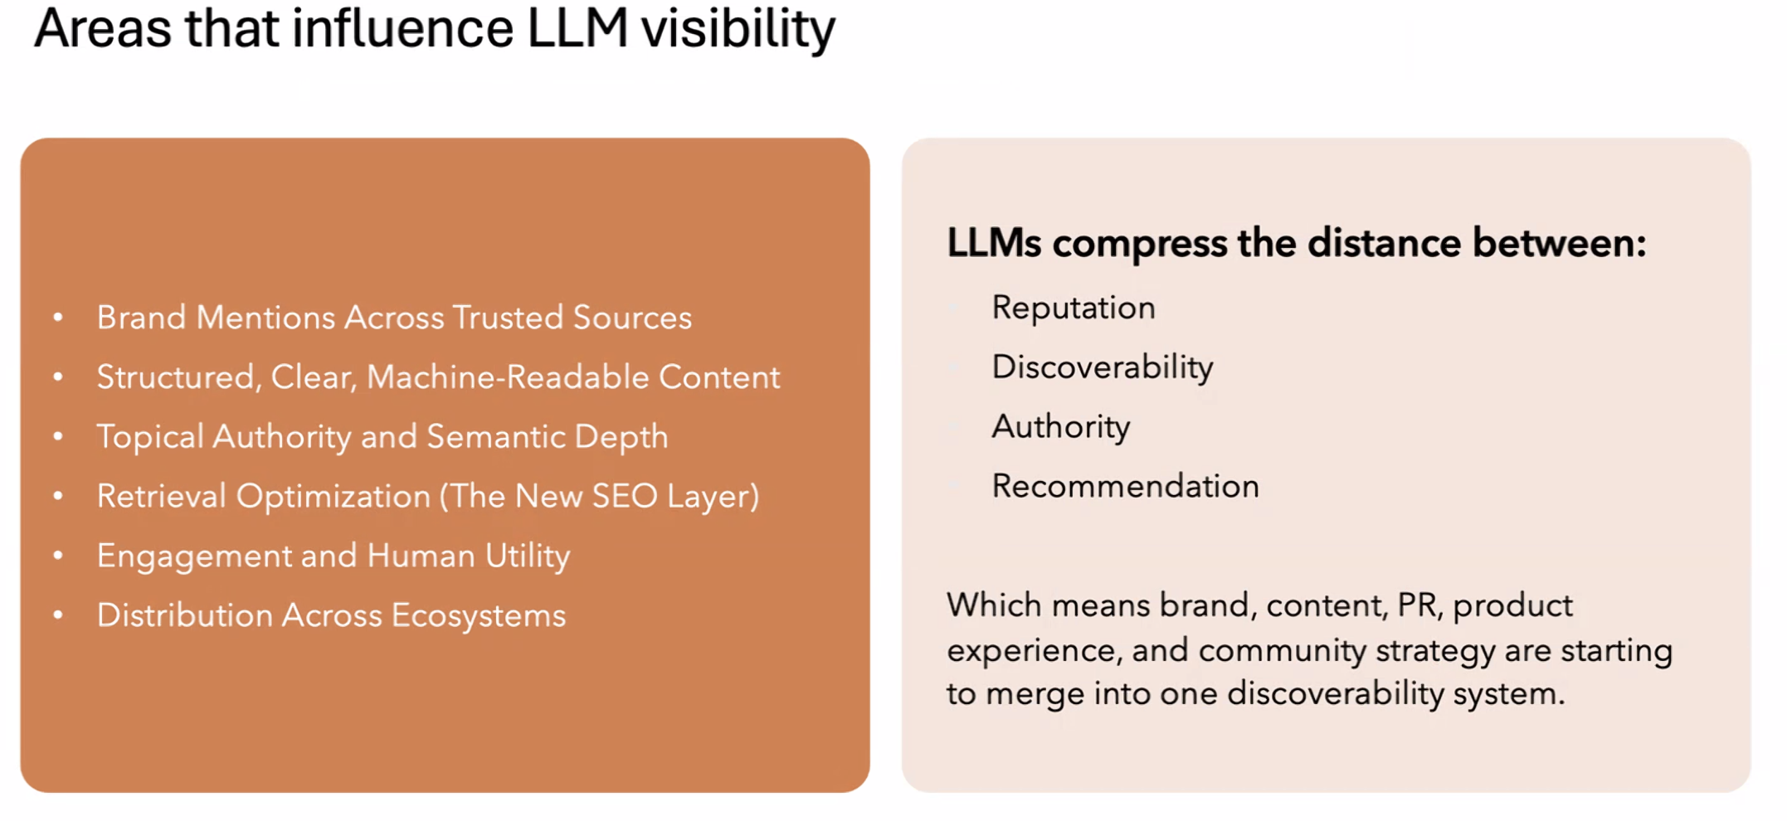

Slide 8
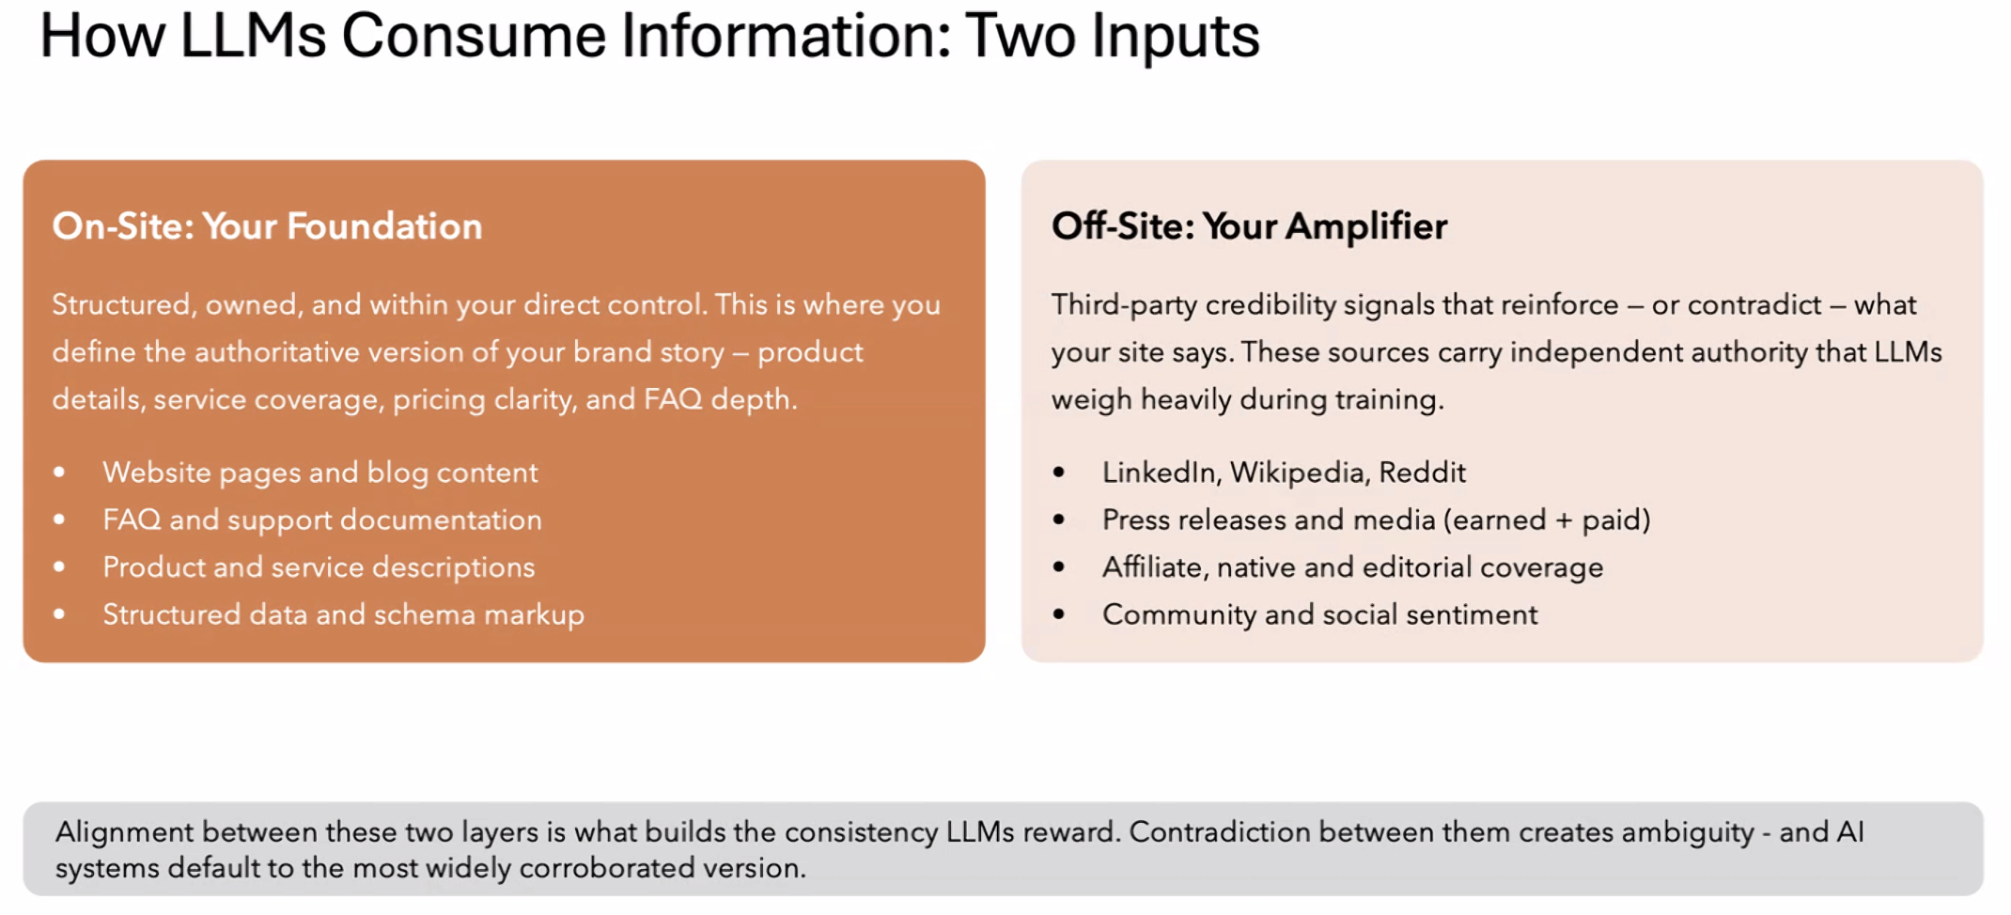
Notes:
Example brooks vs nike

Slide 9
ACT II — WHAT IS REAL
Authenticity Is Now a Competitive Advantage
Research Insight: Influencer Typology
(Peggiani, Lamberti & Pauwels, MSI 2026)
Content Creators — Professional, brand-facing
AI role: Can leverage AI tools without authenticity cost
Self-Journalers — Personal, community-anchored
AI role: Lose core value the moment content feels engineered
Source: Billion Dollar Boy / Digiday, 2026
Most brands are not yet applying this distinction.

Slide 10
ACT II — WHAT IS REAL: WHO GETS IT RIGHT
Three Companies That Get It Right — And Why
Spotify: Wrapped
Nike: Never Done Evolving
Zalando: Segmentation
What AI does:
Surfaces patterns users did not know about themselves from 600M+ streams
What humans do:
The creative concept, the emotional frame, the cultural timing
Result: 60M+ organic social shares in 2023
What AI does:
AI simulates Serena Williams across eras from match data; ML personalizes product recommendations across 500M+ data points
What humans do:
Athletes shape the creative concept; brand strategists set what Nike stands for
Result: Nike By You drives higher conversion; “Never Done Evolving” viral without paid
What AI does:
ML models segment 50M+ customers for offer timing and message personalization
What humans do:
Brand voice, campaign concepts, creative strategy — entirely human-led
Documented conversion uplift in investor materials
AI executes at scale. Humans decide what matters.

Slide 11
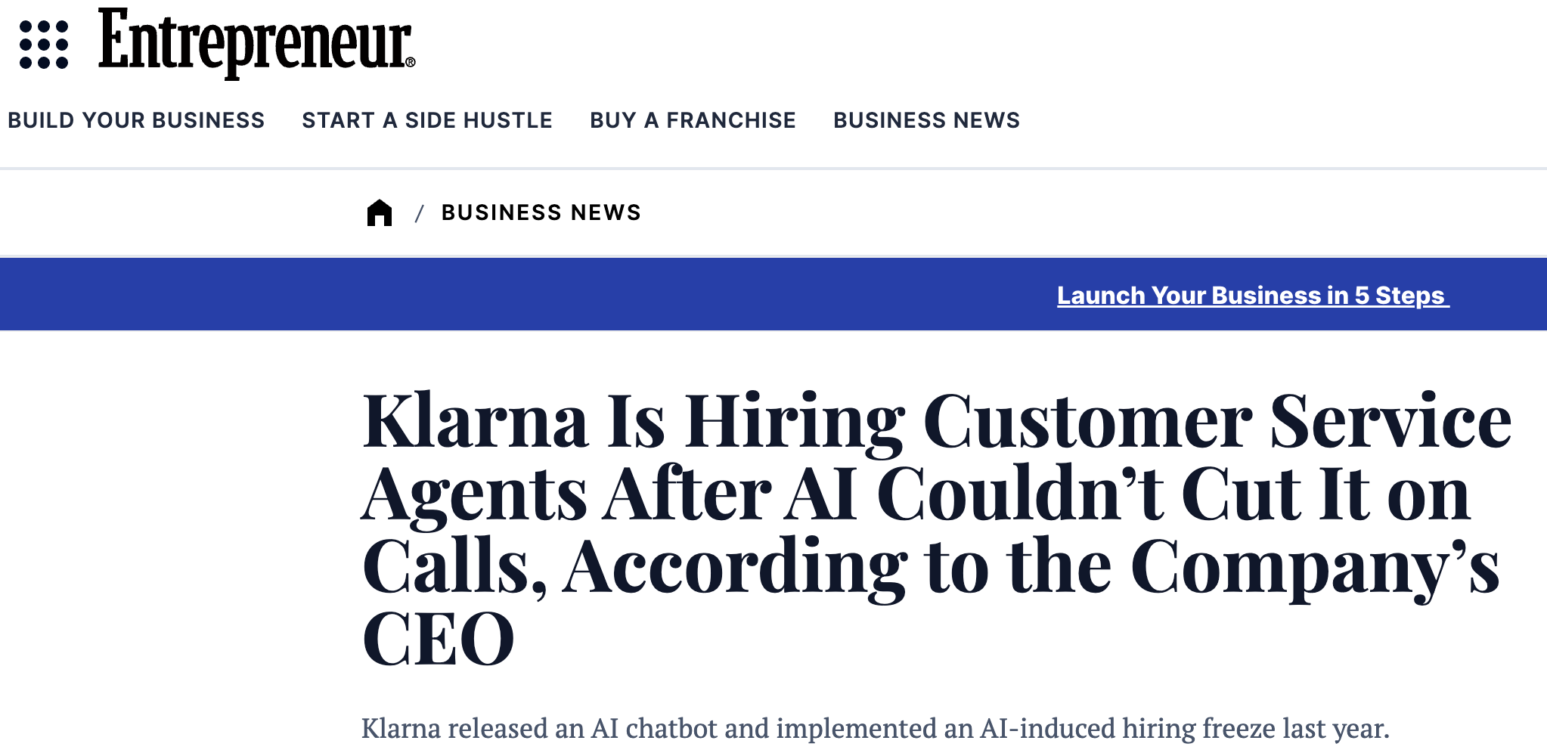
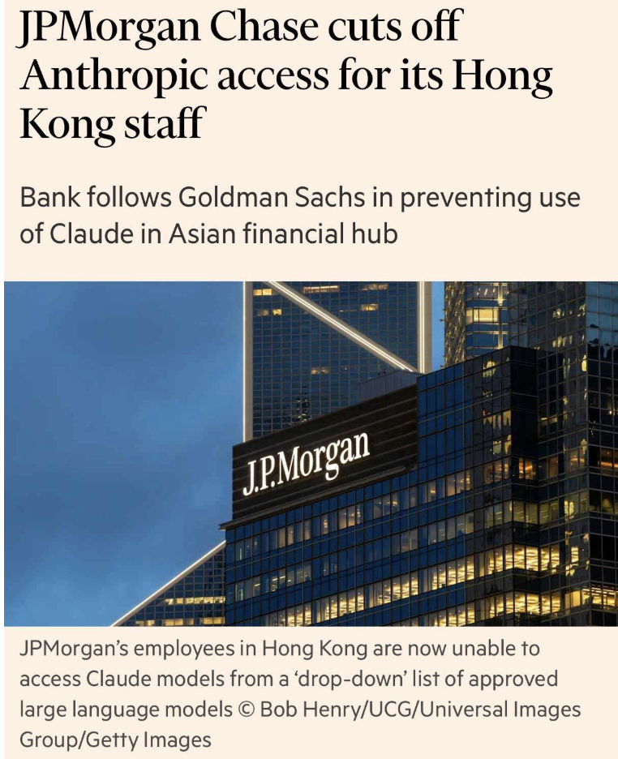
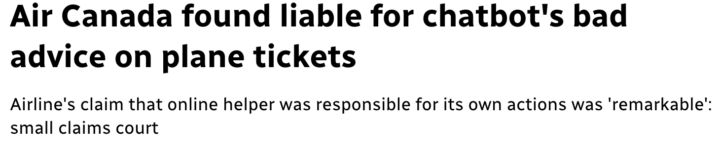
Other companies went in too fast, too furious
1
2
Notes:
Klarna: After touting AI's potential to replace human work, CEO Sebastian Siemiatkowski reversed course and began hiring human customer service agents again. "From a brand perspective, a company perspective, I just think it's so critical that you are clear to your customer that there will always be a human if you want," he told Bloomberg. Between 2022 and 2024, Klarna cut approximately 700 jobs. By early 2025, internal reviews revealed that AI systems lacked empathy and could not handle nuanced problem-solving. Siemiatkowski acknowledged the company "went too far," saying the focus on efficiency and cost ultimately reduced quality and eroded customer trust. Full story: Entrepreneu

Slide 12
ACT III — WHAT TO DO
Where to Invest When, and What to Ignore
FOCUS ON
SET ASIDE
1
Data infrastructure first AI amplifies what you have. It’s not the Size of the Data, It’s what You do with it! Clean data matters. GIGO
The full-automation fantasy Without governance and data maturity, autonomous agents introduce risk as much as their autonomy.
2
LLM brand presence Measure how your brand appears in AI-generated answers. Owned and earned media are key: consistency, social proof
Platform-chasing Adopting every AI tool as a badge of innovation is theater, not strategy.
3
Agentic AI for execution Measurable gains in campaign management, timing, reporting.
Human judgment stays at the strategy level.
The ROI-less pilot In 2026, the conversation shifts from technology to measurable business impact. Demos are not strategies.

Slide 13
Summing it up
AI has transformed the cost structure of marketing execution.
It has not yet transformed what makes brands matter.
That second transformation is coming.
Winning brands know the difference, and act on it now.
Koen Pauwels | Northeastern University & IJRM | Former Principal Research Scientist, Amazon Ads | k.pauwels@northeastern.edu

Slide 14
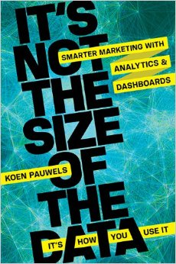
Grazie Mille! Want to learn more?
Contact me at kpauwels@northeastern.edu
LinkedIn handle: koenhpauwels
Newsletter Pauwels on Marketing
My Substack Amazon Days
Publications: marketingandmetrics.com
Podcast: CMO Talk USA
And check out my practical book:
It’s not the Size of the Data, it is How You Use it:
Smarter Marketing with Analytics & Dashboards

